Slide 1

WELCOME TO WCC’s
UPDATED ELECTRONIC CLAIM FORM PROCESS

Slide 2

Benefits of the New Process
Paperless
Claimants’ Attorneys complete and submit entry of appearance along with the C-1 form. This MUST be done by logging into WFMS as a subscribing attorney PRIOR to starting the electronic filing process. The entry of appearance is entered when the completed claim form is electronically submitted to WCC.
Once the claim has been created an email is generated
Claim form can be saved and completed at a later date
The improved verification process allows WCC to complete initial verification much faster.
The subscriber can check the status of the claim after verification
Subscriber may forward email creating E-Number to the client for signature.
Multiple options for capturing claimant’s signature
Claimant access is through the public portal and therefore they can not submit or change the form, only sign
PRIOR

Slide 3
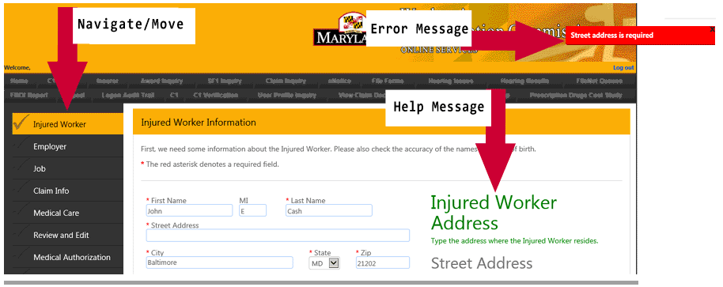

Slide 4
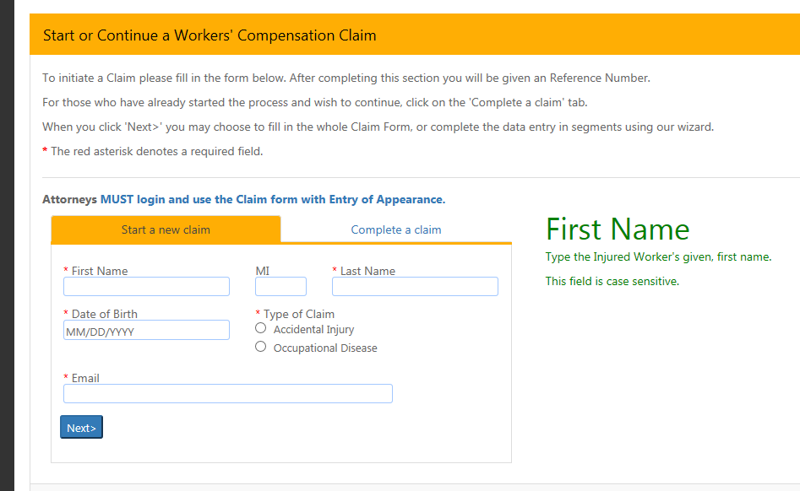

Slide 5
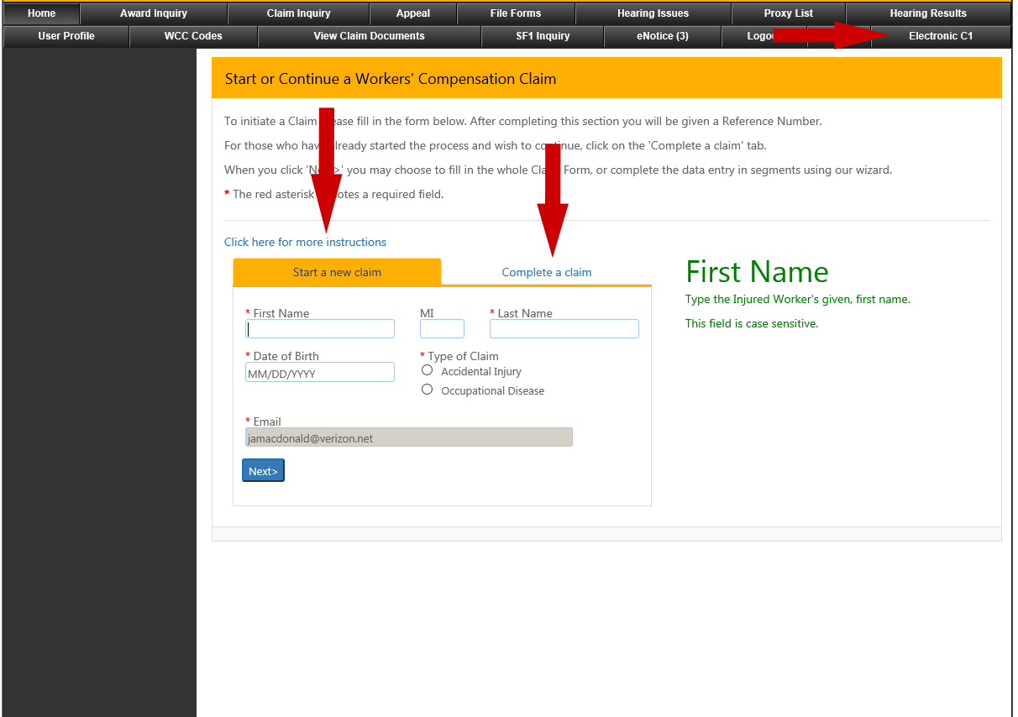

Slide 6
Do’s and Don’ts
If you are completing a claim that is already started, enter the claimant’s name exactly as on the first email
If you want to save the work and come back, write down the EFN number or save the creation email received from the Commission. You will need this information to it to get back into the claim
Sign the claim and medical authorization form prior to submission
Print file copy before submission
Only upload the signature page if executed on paper
Submit your claim within 30 days of creation
Don’t make attachment name too long or include symbols or periods (alphabetical or numerical)
Don’t use an old version of Internet Explorer -use 10/11 only, Google Chrome, or Firefox
Do not use the public version of the C-1
Do not upload the entire claim form that is printed
Do not reuse a claim form that has been started for another claim or claimant. You MUST create a new claim
Do’s
Don’ts

Slide 7

What We Recommend
Long version for first time users
Short version for experienced users
If you want a printed copy of the Claim Form you must print it before submission
Sign up for E-Notice
Use Internet Explorer 10/11 only, Chrome, or Firefox
iPad users may need to add Chrome as a web browser
Disable the pop-up blocker on your web browser
Notes:
Ask Dorothy if line 5 should say “Use Internet Explorer Versions 10/11 only, Chrome, or Firefox”. Instead of saying Windows 10/11.

Slide 8
What to Expect when Claim has been Submitted
Once completed and verified by WCC, you will receive a Notice of Claim via Electronic Notice for subscribers or via the U.S. Postal Service.
Your appearance will be automatically entered when the claim is submitted
You will receive an e-mail:
  When you initiate the claim,
  After the claim has been submitted, and/or
  If the claim is not accepted for processing

Slide 9
What to Remember…
Once a claim has expired for inactivity, it is deleted
Rejected/deleted submissions cannot be reused. You must start a new online claim
Entries are case sensitive
The date stamp will only show after verification and the claim form is in the system
Signature of claimant is required for the Claim and Medical Authorization Form
Write down the EFN number. You will need this to get back into the claim or save the creation email received from WCC

Slide 10
What to Remember continued…
The arrows in the navigation pane to the left will turn green when a page is completed successfully.
Any menu item that does not have a green arrow should be revisited for missing information
Generation of C-30 (Notice of Claim) is created in an overnight process
Attorney proxy must be registered as a proxy for a specific attorney in order to file claim on behalf of that attorney
E-mail notices go to the attorney’s e-mail address
Once notified that the claim form is signed electronically by client, attorney should review and confirm that the signature is visible prior to submitting

Slide 11
Regulations…
The Commission has promulgated regulations to codify the new filing processes.
Regulations will be published in early December.

Slide 12

Further Questions
You may contact the Public Service Department at info@wcc.state.md.us or via telephone (410) 864-5100 during normal business hours.
For technical assistance only, contact websupport@wcc.state.md.us.

